Slide 1
News from the Trade War
Alan V. Deardorff
For presentation to
Ford School Faculty Lunch
May 28, 2019

Slide 2
Source for most of this
http://www-personal.umich.edu/~alandear/news/TradeNews.html

Slide 3
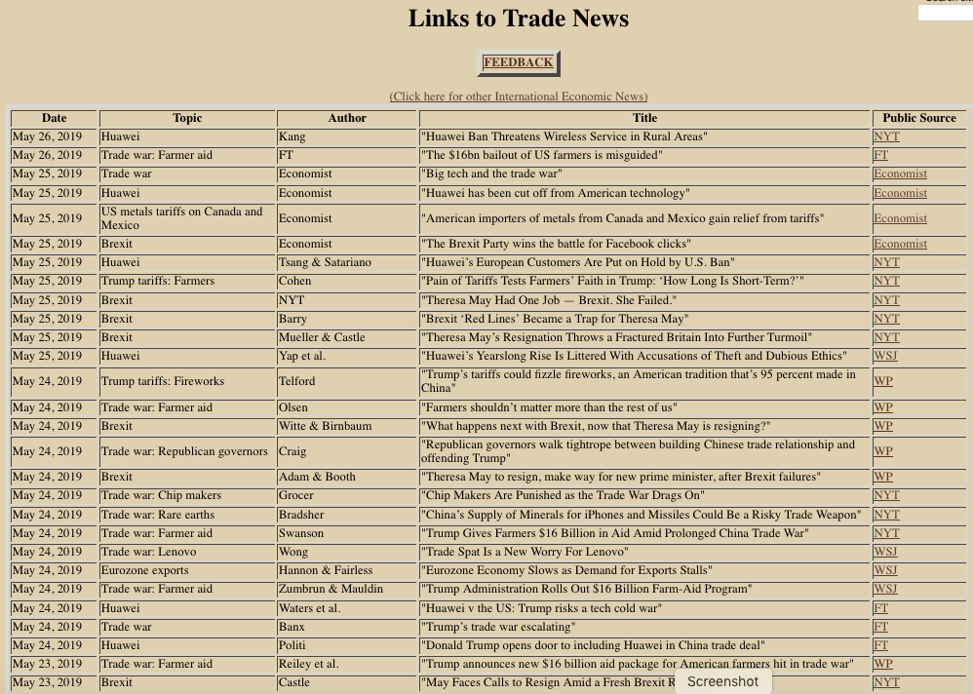

Slide 4
1-8/2015
Greece Crisis
3/18-present
Trade war
2011-2013
Eurozone Crisis
6/23/2016
Brexit Vote

Slide 5
Trade War?
Slide from Faculty Lunch, Mar 27, 2018
Is this a trade war? Or will it be?
Too soon to say
The safeguard tariffs on solar panels and washing machines were normal uses of trade laws
The national security tariffs on steel and aluminum were not normal, but were vastly scaled back to mostly China and Russia
The tariffs on China, just announced, are still unknown
Don’t know yet if there will be
Retaliation
Counter-retaliation

Slide 6
Trade War!
Now we know: It is a trade war!
Steel and Aluminum tariffs were extended to EU, Canada, Mexico
Tariffs were levied in 3 rounds on China
All were retaliated against with tariffs on US exports

Slide 7
Casualties of the Trade War (& beneficiaries)
Soybeans (FT 6/24/18: US tariffs tip soyabean balance in Brazil’s favour)
Harley Davidson (FT 6/25/18: US trade war with Europe revs up as Harley-Davidson shifts production)
Cheese (NYT 6/25/18: Trump’s Trade War Could Shut Cheesemakers Out of Foreign Markets)
Chips: (WSJ 6/26/18: Chip-Equipment Makers in Crosshairs of Trade War)
Farm belt: (WSJ 7/2/18: Trade Fight Threatens Farm Belt Businesses)
Cars: (NYT 7/2/18: Automakers Report June Sales and China Tariffs Will Take Effect)
Tech devices: (FT 7/3/18: Millennials’ favourite gadgets dragged into trade war)
Ketchup: (FT 7/6/18: American ketchup next on EU’s list of trade targets)
Bourbon: (FT 7/6/18: No bourbon party in Kentucky as tariffs drown exports)
Rare earths: (NYT 7/12/18: How Rare Earths (What?) Could Be Crucial in a U.S.-China Trade War)

Slide 8
Casualties of the Trade War
Michigan: (NYT 7/13/18: Trump’s Trade War With China Pierces the Heart of Michigan)
Airplanes: (WSJ 7/16/18: Global Trade Spat Unnerves Plane Makers)
Meat: (WSJ 7/23/18: 2.5 Billion Pounds of Meat Piles Up in U.S. as Production Grows, Exports Slow)
Coke: (WSJ 7/26/18: Coke Raising U.S. Soda Prices, Citing Tariffs)
Apple: (FT 7/29/18: Apple accessories at risk from Trump tariff threat)
Almonds: (WSJ 7/30/18: U.S. Almond Farmers Are Reeling From Chinese Tariffs)
Honda: (WSJ 8/1/18: Motorcycles Are Helping Honda Get a Handle on Tariffs)
Pig feet: (WP 8/1/18: Chinese merchants fear Trump’s trade war is hurting a popular snack: Pig feet)
Copper: (WSJ 8/2/18: Copper Drops on New Tariff Threats)
Kidney beans: (WSJ 8/3/18: Kidney Beans Piled to the Rafters: Tariffs Are Biting in Farm Country)
BMW: (WSJ 8/3/18: BMW Weighs Measures to Counter Tariff Impact)

Slide 9
Casualties of the Trade War
Cranberries: (WSJ 8/6/18: U.S. Cranberry Industry Feels the Bite of Retaliatory Tariffs)
Samsung: (WSJ 8/6/18: Samsung Tries to Navigate Through U.S.-China Trade Crossfire)
Cloud computing: (FT8/7/18: US-China trade tariffs cast shadow over cloud computing boom)
Small Business: (WSJ 8/8/18: ‘We Are at the Limit’: Trump’s Tariffs Turn Small Businesses Upside Down)
Natural gas: (WSJ 8/18/18: Trade Fears Throw Future of U.S. Natural Gas Into Question)
Foreign banks in China: (FT 8/19/18: Trade war imperils foreign banks’ China plans)
Supply chains: (FT 9/3/18: Sino-US trade war prompts rethink on supply chains)
Tech startups: (FT 9/11/18: Tech start-ups bear the brunt of US tariffs on China)
US companies in China: (FT 9/12/18: Three in five US companies in China hurt by trade war tariffs)

Slide 10
Casualties of the Trade War
Christmas: (WP 9/17/18: Trump could play Scrooge this holiday season)
Designer bags: (WP 9/19/18: Trump’s trade war brings unexpected boom for knockoff designer bags from China)
Auto parts: (WSJ 9/20/18: Latest U.S. Tariffs Could Make Auto Parts Pricier)
RVs: (FT 9/23/18: Trump tariffs risk tarnishing American dream of mobility)
CB radios: (WP 9/23/18: Over and out: CB radio-maker struggles to adjust to Trump tariffs)
Windsor, ON: (FT 9/28/18: The Canadian border city on front line of Trump’s tariff threats)
US food banks: (FT 9/30/18: Trump's trade wars fill US food banks to overflowing)
Oil: (WSJ 10/16/18: Another Victim of the Trade Spat: U.S. Oil to China)
Pork: (WSJ 10/19/18: America Struggles to Take Its Pigs to World’s Biggest Market)
Pet food: (NYT 10/23/18: The Trade War’s Latest Casualties: China’s Coddled Cats and Dogs)

Slide 11
Casualties of the Trade War
Transport workers: (WP 10/24/18: Hurt by Trump’s trade war, ineligible for a bailout)
Foxconn: (FT 10/26/18: Foxconn slumps as worries build over trade war, iPhone margins)
Tourists: (WP 10/29/18: China has a big weapon that it hasn’t used in the trade war — yet. Tourists.)
Taiwan: (FT 10/31/18: Taiwan factory gauge slumps as trade war worries rise)
Asian growth: (FT 11/4/18: US-China trade war starts to drag on Asian growth)
China’s neighbors: (WSJ 11/7/18: China’s Neighbors Could Win From U.S. Tariff Tussle)
AI: (FT 11/19/18: US considers export controls on AI and other new tech)
Columbia Sportswear: (NYT 11/24/18: A Winter-Coat Heavyweight Gives Trump’s Trade War the Cold Shoulder)
Consumer variety: (WSJ 11/29/18: Consumer Beware: With Less Trade Comes Less Choice)

Slide 12
Casualties of the Trade War
Australia farmers: (NYT 12/2/18: As U.S.-China Trade War Rages, Some Australian Farmers See an Opportunity)
GoPro: (FT 12/10/18: GoPro shifts production out of China to avoid tariff threat)
Kitchens: (WSJ 12/27/18: How Tariffs Could Trickle Down to Your Kitchen Remodel)
India: (FT 1/1/19: India vies to fill Chinese commodities gap created by trade war)
Whiskey: (WP 1/2/19: Whiskey sour: U.S. craft distillers say Trump trade war with Europe is killing export plans
Steel: (FT 1/8/19: US steel prices fall to pre-tariff levels amid China slowdown worries)
Aluminum scrap: (WSJ 1/17/19: Aluminum Scrap Abounds Thanks to Tariffs)
EU: (FT 2/4/19: US-China tariff war will divert trade to EU, says UN)
Deere: (FT 2/15/19: Trade concerns weigh on earnings at tractor maker Deere)

Slide 13
Casualties of the Trade War
Germany, Japan: (WSJ 2/15/19: Trade Friction Stymies Growth in Germany and Japan)
Russia soybeans: (WSJ 2/22/19: A Surprise Winner From the U.S.-China Trade Spat: Russian Soybean Farmers)
Lighting: (NYT 3/5/19: Illuminating the Risks of Trump’s China Trade War)
Volvo: (FT 3/6/19: Volvo’s Polestar electric car brand warns of US tariff impact)
Rubber: (WSJ 3/13/19: Rubber Ducks a Deeper Slump on Trade-Deal Hopes)
LNG: (FT 3/29/19: US-China trade war casts chill over liquefied natural gas market)
Milk farmers: (NYT 4/27/19: Stung by Trump’s Trade Wars, Wisconsin’s Milk Farmers Face Extinction)
Macy’s: (FT 5/15/19: Macy’s warns more Trump tariffs are threat to earnings)
Cisco: (FT 5/16/19: Cisco cuts back China manufacturing to ease tariffs hit)

Slide 14
Casualties of the Trade War
Bicycles: (WSJ 5/18/19: Tariffs Put a Dent in the Bicycle Business)
Game of Thrones: (WSJ 5/21/19: ‘Game of Thrones’ Finale Frozen Out in China by Trade Fight)
Junk loans: (WSJ 5/21/19: Trade Battle Poses Risks for Junk-Loan Machinery)
World: (FT 5/21/19: The US-China conflict challenges the world)
Retailers: (WSJ 5/22/19: Big Retailers’ Sales Lag as They Gird for Tariffs)
Android: (WSJ 5/22/19: U.S.-China Trade War Could Block Android’s Two-Way Street)
Lenovo: (WSJ 5/24/19: Trade Spat Is a New Worry For Lenovo)
Republican governors: (WP 5/24/19: Republican governors walk tightrope between building Chinese trade relationship and offending Trump)

Slide 15
Effects of the Tariffs
Two recent studies examine the tariffs of 2018:
Amiti, Redding, and Weinstein, “The Impact of the 2018 Trade War on U.S. Prices and Welfare,” CEPR Discussion Paper DP13564, March 1, 2019.
Fajgelbaum, Goldberg, Kennedy, and Khandelwal, “The Return to Protectionism,” NBER Working Paper #25638, March 3, 2019.

Slide 16
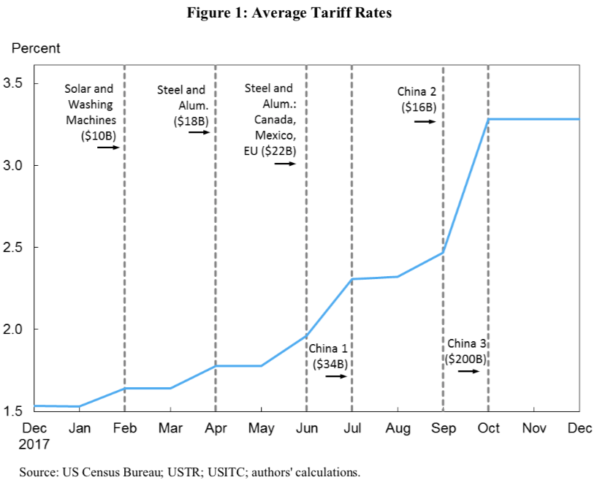
Waves of tariffs:
1 2 3 4 5 6
Source: Amiti, et al. 2019.

Slide 17
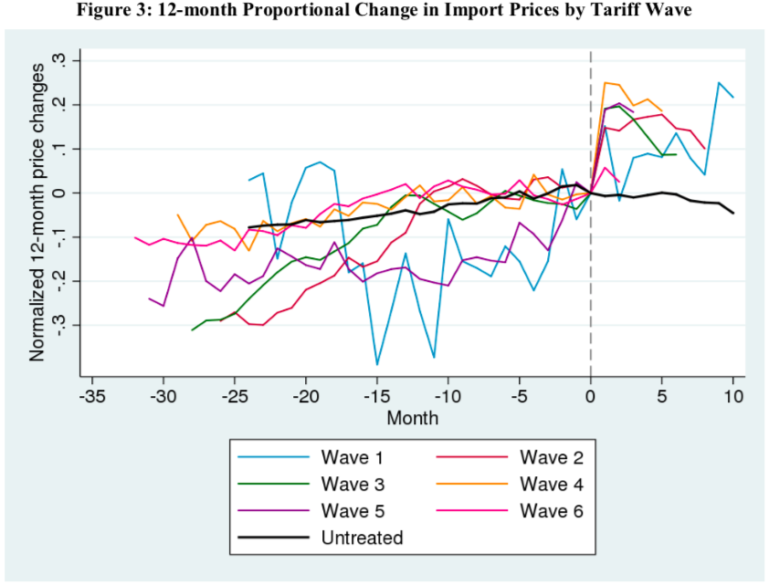
Source: Amiti, et al. 2019.

Slide 18
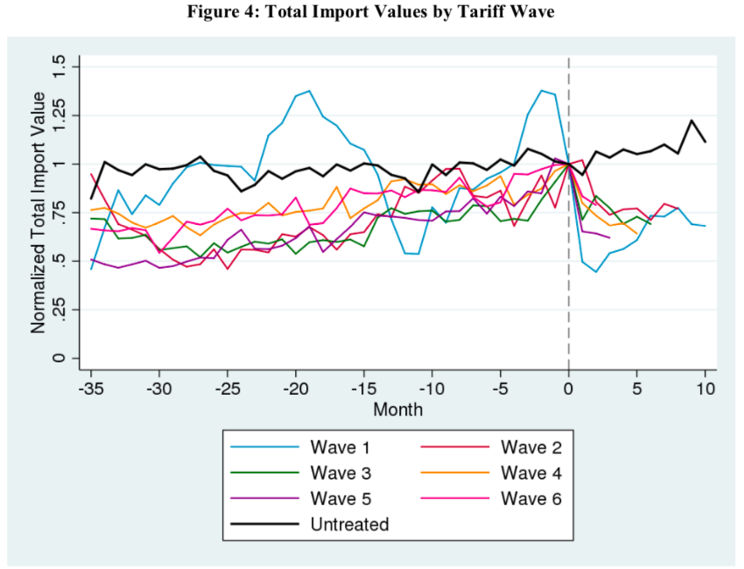
Source: Amiti, et al. 2019.

Slide 19
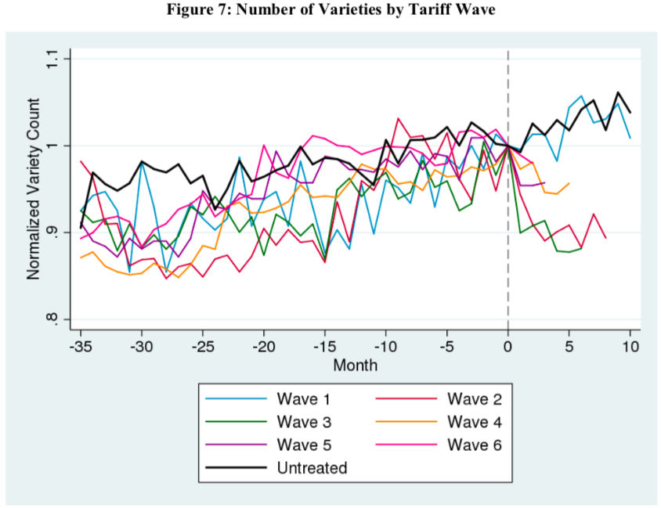
Source: Amiti, et al. 2019.

Slide 20
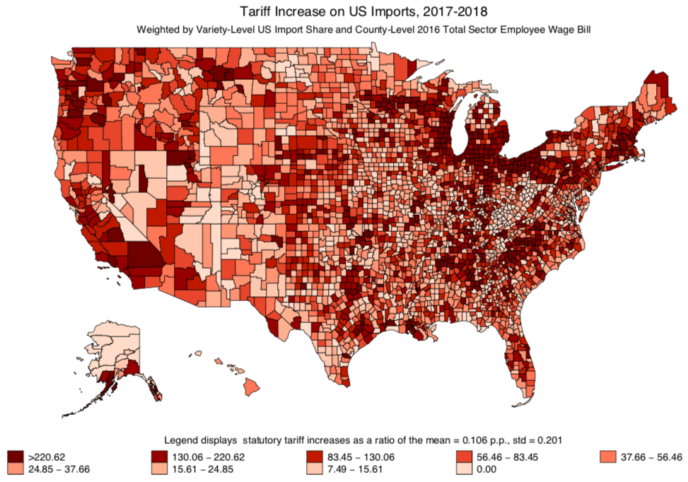
Trade War
Tariff Increase on US Imports
Source: Fajgelbaum, et al. 2019.

Slide 21
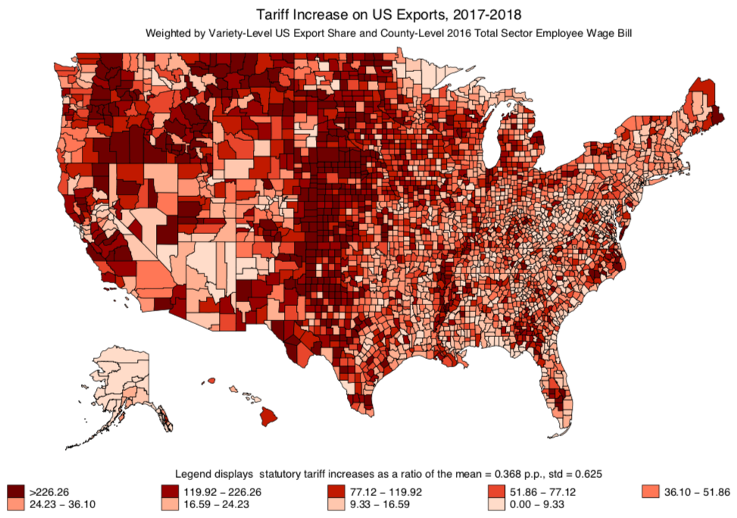
Trade War
Tariff Increase on US Exports
Source: Fajgelbaum, et al. 2019.

Slide 22
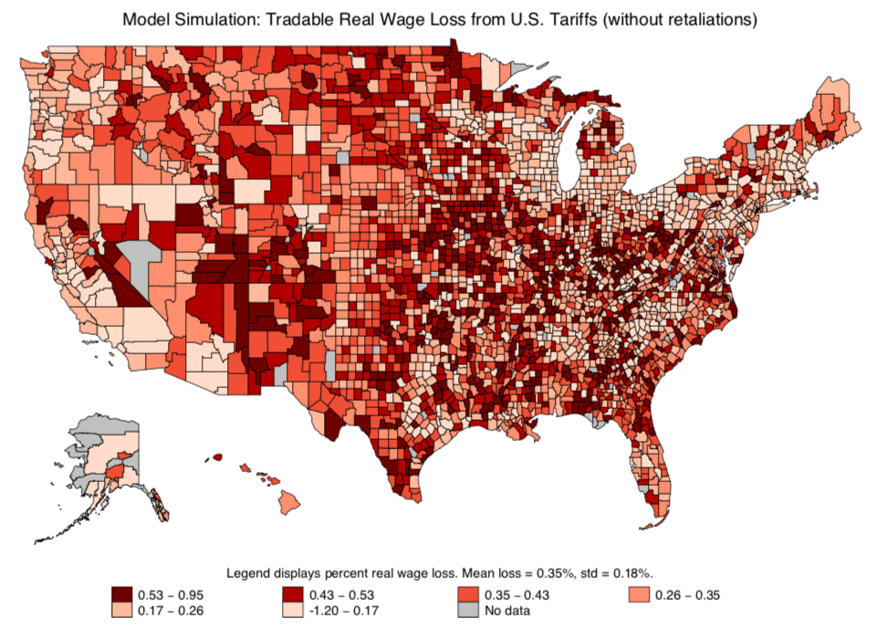
Tradable Real Wage Loss from US Tariffs (without retaliation)
Source: Fajgelbaum, et al. 2019.

Slide 23
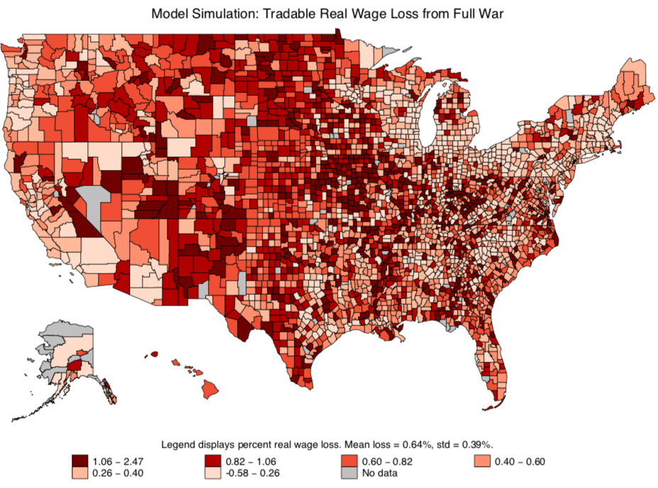
Tradable Real Wage Loss from Full War
Source: Fajgelbaum, et al. 2019.

Slide 24
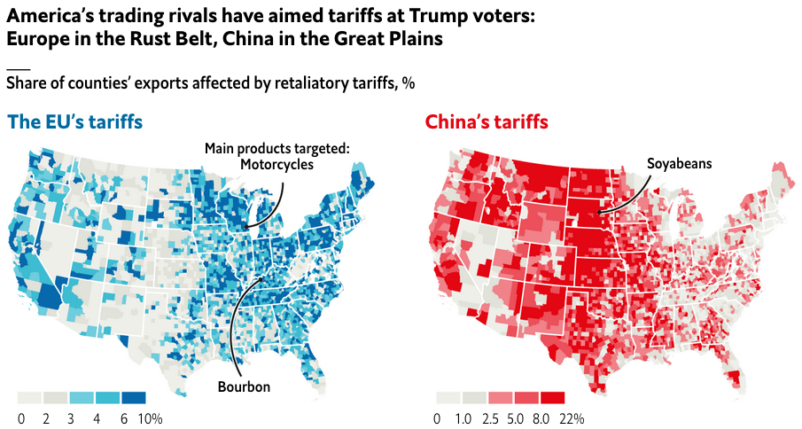
Trade War
Tariff Increases on US Exports: EU vs China
Source: Economist 4/27/19
Notes:
https://www.economist.com/graphic-detail/2019/04/27/why-you-should-never-start-a-trade-war-with-an-autocracy

Slide 25
Trade Talks
China-US Trade Talks, I
Talks began in May 2018, in response to Trump’s threat of tariffs
China promised to import more from US and allow more foreign investment
Said to have “averted trade war”
But then talks broke off in early June
Trade war with China followed
Jul, Aug, Sep 2018

Slide 26
Trade Talks
China-US Trade Talks II
Oct 2018: US and China postured about renewing trade talks
Nov 1, 2018: New round of talks began with phone call from Trump to Xi
Dec 2, 2018: G20 Summit dinner agrees truce: No more tariffs while talks continue
Talks are still underway, but said to be approaching a deal

Slide 27

Trade Talks: Calendar
China-US Trade Talks II: Calendar
Nov 9: He & Mnuchin talk by phone
Jan 7-9: Talks in Beijing
Jan 30-31: Talks in DC
Feb 11-15: Talks in Beijing
Feb 21-24: Talks in DC
Mar 28-29: Talks in Beijing
Apr 3-5: Talks in DC
Apr 23-?: Talks in Beijing
May 8-10: Talks in DC
None further yet scheduled
May 10: Trump
Raised tariffs on $200 bn from 10% to 25%
Began process to impose tariffs on $300 bn more
China responded by raising tariffs on $60 bn of US exports
Source:
Notes:
https://www.china-briefing.com/news/the-us-china-trade-war-a-timeline/

Slide 28
Trade Talks: Headlines
Feb 28, WSJ: U.S. Drops Threat of 25% Tariffs on Chinese Goods in Sign That Accord Is Near
Mar 4, WSJ: U.S., China Close In on Trade Deal
Mar 8, FT: Trump prepared to walk away from ‘bad’ China trade deal
Mar 8, NYT: Chinese Officials Becoming Wary of a Quick Trade Deal
Mar 18, NYT: Trade Fight With China Enters Overtime, With Tariffs a Costly Sticking Point
Mar 28, FT: US-China trade talks could stretch for ‘months’ — Kudlow
Apr 3, FT: US and China draw closer to final trade agreement
Apr 4, FT: US and China push back timing of possible trade deal
Apr 30, WSJ: Mnuchin Suggests China Trade Talks Could Wrap Up by End of Next Week
May 6, WP: Trump administration accuses Chinese officials of ‘reneging’ on commitments in trade talks
May 9, WSJ: China Hardens Trade Stance as Talks Enter New Phase
May 17 WSJ: China Says It Doesn’t Know About U.S. Plans for Beijing Trade Talks
Nov 29, WSJ: U.S., China Exploring Deal to Ease Trade Tensions
Dec 4, WSJ: Trump Names Lighthizer to Run U.S.-China Negotiations
Dec 30, FT: China and US hail ‘positive progress’ on trade talks
Jan 7, WP: Trade talks open in Beijing amid optimism about an end to U.S.-China dispute
Jan 9, FT: China and US strike upbeat tone after talks but offer few details
Jan 22, FT: US turns down China offer of preparatory trade talks
Jan 24, FT: US commerce secretary Ross says US ‘miles’ from a trade deal with China
Jan 29, WSJ: Big Divides Remain as U.S.-China Trade Talks Resume
Jan 31, FT: Donald Trump says US-China trade talks ‘going well’
Feb 6, WSJ: Agriculture Execs Say U.S.-China Trade Deal Nearing
Feb 13, WSJ: China, U.S. Seek Broad Outline of a Trade Pact This Week
Feb 15, FT: US-China trade talks end with little sign of progress
Feb 16, WSJ: Chinese, U.S. Trade Negotiators Inch Toward a Broad Agreement
Feb 21, FT: A potential new snag in the US-China trade talks
Feb 23, WSJ: China Trade Talks Extended as Trump Pushes to Close the Deal

Slide 29
Trade Talks: Headlines
Exploring deal
Accord is near
Trade talks open
Feb 28, WSJ: U.S. Drops Threat of 25% Tariffs on Chinese Goods in Sign That Accord Is Near
Mar 4, WSJ: U.S., China Close In on Trade Deal
Mar 8, FT: Trump prepared to walk away from ‘bad’ China trade deal
Mar 8, NYT: Chinese Officials Becoming Wary of a Quick Trade Deal
Mar 18, NYT: Trade Fight With China Enters Overtime, With Tariffs a Costly Sticking Point
Mar 28, FT: US-China trade talks could stretch for ‘months’ — Kudlow
Apr 3, FT: US and China draw closer to final trade agreement
Apr 4, FT: US and China push back timing of possible trade deal
Apr 30, WSJ: Mnuchin Suggests China Trade Talks Could Wrap Up by End of Next Week
May 6, WP: Trump administration accuses Chinese officials of ‘reneging’ on commitments in trade talks
May 9, WSJ: China Hardens Trade Stance as Talks Enter New Phase
May 17 WSJ: China Says It Doesn’t Know About U.S. Plans for Beijing Trade Talks
Nov 29, WSJ: U.S., China Exploring Deal to Ease Trade Tensions
Dec 4, WSJ: Trump Names Lighthizer to Run U.S.-China Negotiations
Dec 30, FT: China and US hail ‘positive progress’ on trade talks
Jan 7, WP: Trade talks open in Beijing amid optimism about an end to U.S.-China dispute
Jan 9, FT: China and US strike upbeat tone after talks but offer few details
Jan 22, FT: US turns down China offer of preparatory trade talks
Jan 24, FT: US commerce secretary Ross says US ‘miles’ from a trade deal with China
Jan 29, WSJ: Big Divides Remain as U.S.-China Trade Talks Resume
Jan 31, FT: Donald Trump says US-China trade talks ‘going well’
Feb 6, WSJ: Agriculture Execs Say U.S.-China Trade Deal Nearing
Feb 13, WSJ: China, U.S. Seek Broad Outline of a Trade Pact This Week
Feb 15, FT: US-China trade talks end with little sign of progress
Feb 16, WSJ: Chinese, U.S. Trade Negotiators Inch Toward a Broad Agreement
Feb 21, FT: A potential new snag in the US-China trade talks
Feb 23, WSJ: China Trade Talks Extended as Trump Pushes to Close the Deal
‘Miles’ from a trade deal
Talks could stretch for ‘months’
Trade deal nearing
Wrap up by end of week
Little sign of progress
Trump accuses reneging;
China hardens stance
No plans

Slide 30
Trade Talks: Issues
China-US Trade: Issues of Negotiation
Government subsidies to state-owned companies
Chinese purchases of U.S. farm and energy products and services
China’s market-opening efforts in sectors such as financial services and manufacturing
Improving its protection of U.S. intellectual-property rights
Pressure on U.S. companies to share technology
Industrial policies that favor state-controlled companies
Currency stability
Regulatory relief for foreign companies in China
How to enforce any agreements on the above
Reimpose tariffs, or
Leave them in place

Slide 31
Trade Talks
What Might a China-US Trade Deal Include?
US wants (per FT, 3/25/19):
Huge Chinese purchases of US exports, to reduce US trade deficit
Liberalization of market access for US goods and services
Reform of Chinese industrial policy, especially “forced transfers” of IP
US permitted to use punitive tariffs if these are violated, without China retaliating or complaining to WTO
China wants:
Removal of US tariffs
Notes:
https://www.ft.com/content/58f098fc-6201-11e9-b285-3acd5d43599e

Slide 32
That’s it, for now.
Questions?

